Slide 1
Shell Bootcamp 2024 3 Reflections for Week 1
Anisha Sharma
Date : 6-Sept-2024

Slide 2

About Me
‘According to me’ is the only ‘according to’ that matters

Slide 3

My learnings from this week!

Slide 4
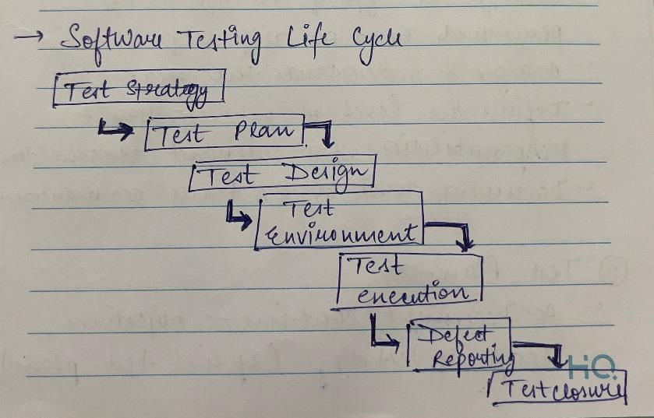
Learning 1 | My takeaways
We learnt about Software testing Life cycle and its features.
Key learning: Designing and developing test cases and test scripts based on the requirements. This includes creating detailed test cases, test data, and identifying expected results.
Key takeaway: A test plan document is created, outlining the strategy and approach for testing.
Testers execute the test cases, report defects, and retest the fixed defects.

Slide 5
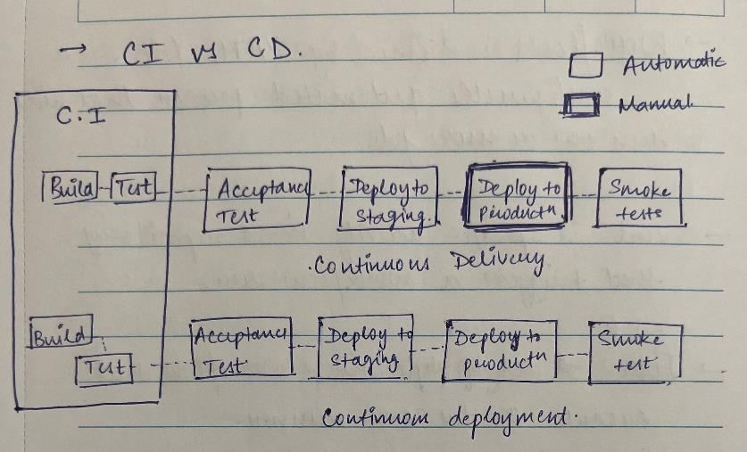
Learning 2 | My takeaways
Continuous Integration and Continuous Deployment
Key learning: CI allows for frequent code integration and automated testing, which helps in identifying and fixing issues early in the development process.
Key takeaway: Automated testing and deployment in CI/CD ensure that only thoroughly tested and stable code is released.
CI/CD can facilitate the seamless integration of renewable energy sources into the main grid.

Slide 6
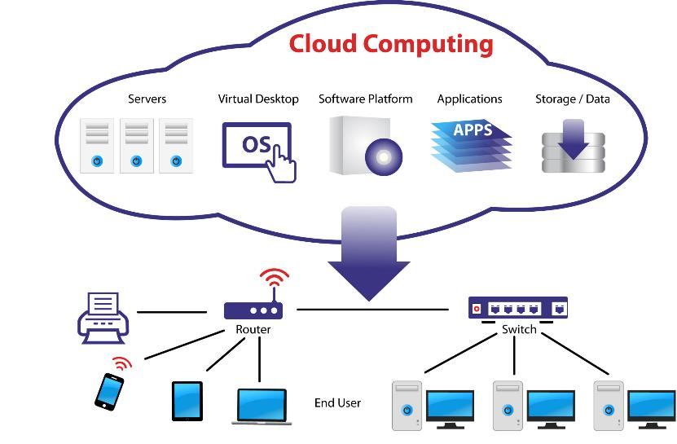
Learning 3 | My takeaways
DBMS and Cloud Computing
Key learning: DBMS allows for the centralization of vast amounts of energy data, making it easier to manage, access, and analyze.
Key takeaway: With accurate and consistent data, energy companies can make more informed decisions regarding energy production, distribution, and consumption.
DBMS helps in managing data related to energy assets, such as power plants, grids, and renewable energy sources, ensuring optimal performance and maintenance.

Slide 7

Relevance of learnings for my organization

Slide 8

Learning 1 | Relevance for Shell
Shell relies on complex software systems for various operations, including exploration, production, and distribution of energy. The STLC helps ensure these systems are reliable by identifying and fixing defects early in the development process, thereby minimizing the risk of system failures.

Slide 9
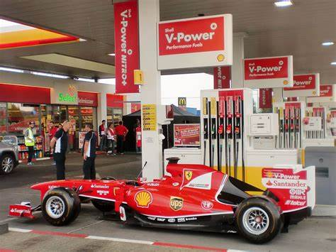
Learning 2 | Relevance for Shell
CI/CD practices ensure that code changes are frequently integrated and tested, which helps in identifying and fixing issues early. This leads to higher quality and more reliable software systems, which are crucial for Shell’s complex operations, such as managing energy production and distribution.

Slide 10
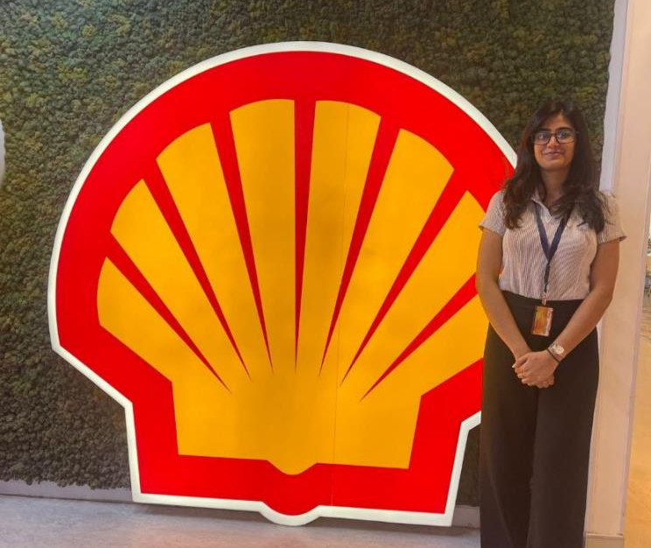
Learning 3 | Relevance for Shell
Shell deals with vast amounts of data from various sources, including exploration, production, and distribution. A DBMS allows Shell to efficiently store, manage, and retrieve this data, ensuring data integrity and accessibility for analysis and decision-making.

Slide 11

Challenges in implementing learning

Slide 12
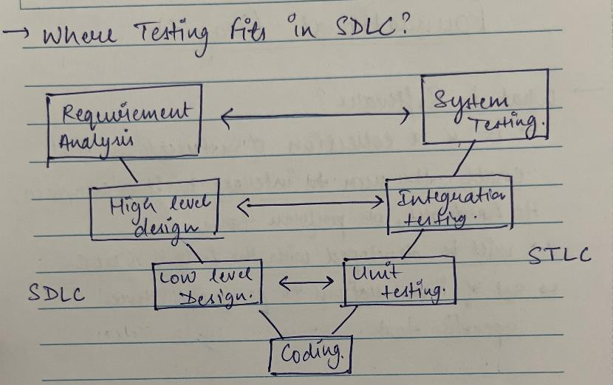
Challenge faced while implementing Learning 1
Complex Integration: Merging the Software Testing Life Cycle (STLC) with the Software Development Life Cycle (SDLC) can be challenging. Solution: Utilize thorough documentation and effective collaboration tools.
Tool Proficiency: Gaining expertise in various DevOps tools requires significant time and practice. Solution: Offer extensive training programs and practical workshops.
Continuous Adaptation: Staying updated with the latest DevOps practices and technologies is essential. Solution: Promote ongoing learning and regular updates.

Slide 13
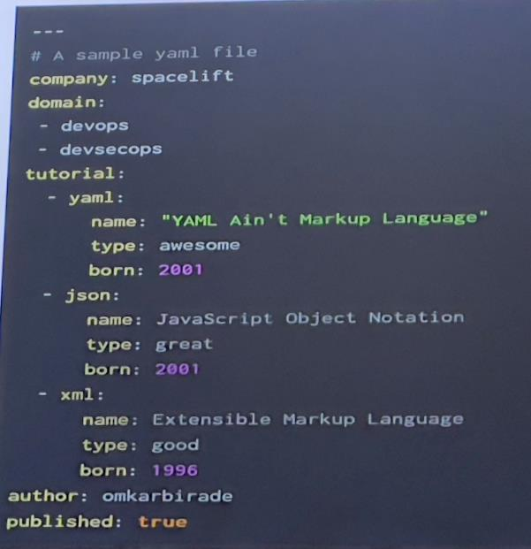
Challenge faced while implementing Learning 2
Ensuring that test environments are consistent and up-to-date can be challenging. Inconsistent environments can lead to false positives or negatives in testing, which can undermine the reliability of the CI/CD pipeline.

Slide 14
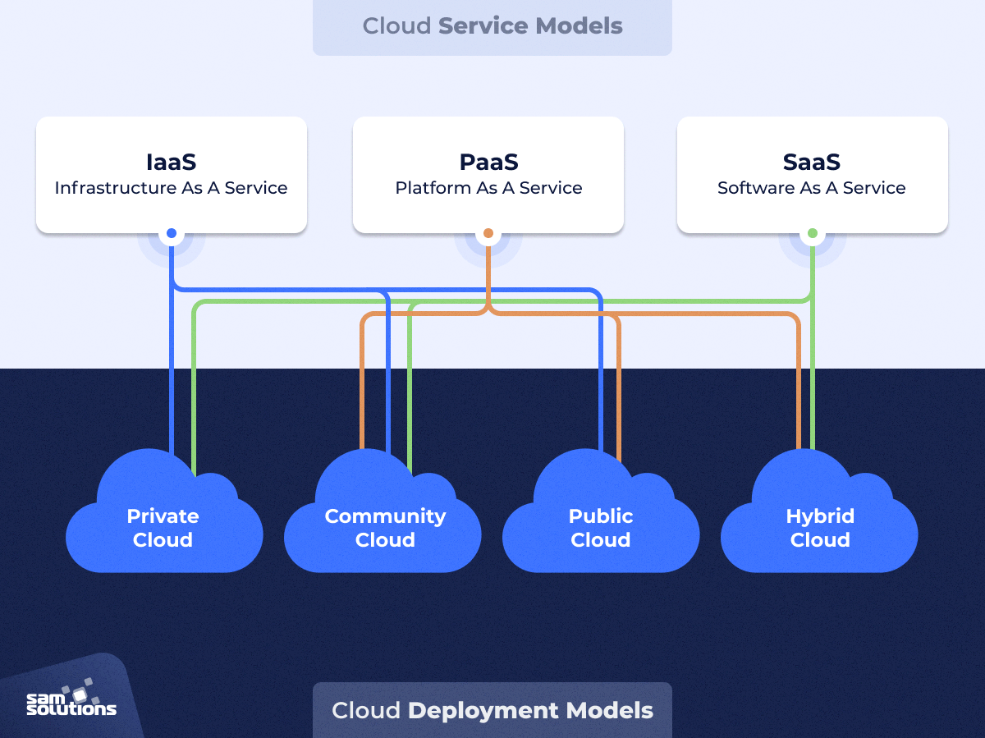
Challenge faced while implementing Learning 3
Configuring Azure AD, VMs, and networking can be intricate. Grasping different database types and operations is essential. Effectively implementing cloud scalability and elasticity can be challenging.

Slide 15

Action Plan

Slide 16
My Action Plan for this Week
Actions
Timeline
Status
Interacting with my peers from other batches.
Participated in the group activities.
Kept learning new topics
SDLC and STLC, DevOps, DBMS, Cloud Computing, and Case Study
Ended the week and foundational training by completing the Case Study.

Slide 17

Learning is also Fun!

Slide 18
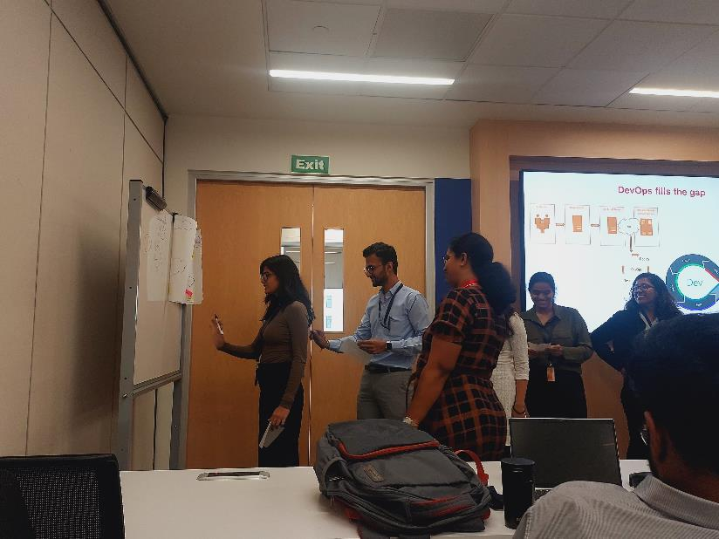
Learning is also Fun!
Our facilitators for Foundational Training conducted the sessions in a very fun manner.
In the foundational training she taught us about the agile model framework and STLC. We even played few fun games in between the sessions to interact with each other. Then we had hands on experience on DevOps and DBMS.

Slide 19

Summary
Quick summary
This week we had our Foundational Training where we were taught about the importance of Agile Framework, SDLC and STLC, DevOps, DBMS and Cloud Computing. We even had some roleplays and JAM sessions everyday to brush up the topics..
Importance of topics of upcoming week
The upcoming topics are going to be very technical and related to our line of business.
Connectivity of topics from current week
This week’s topics like SDLC and STLC are always going to help me in creating a proper workflow of my work.

Slide 20
Thank You

